Slide 1
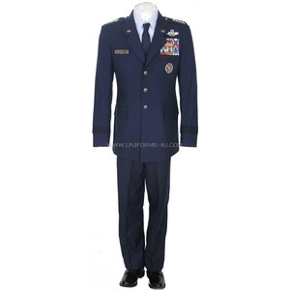
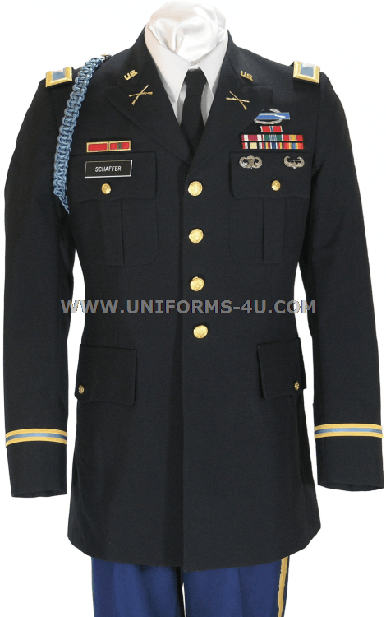
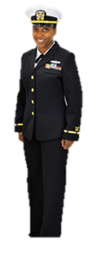
GSACEP Military Uniform Guide
By: Danny Jones, MD(Army); Taylor George, MD(Navy); Brent Lavey (Air Force)

Slide 2
Disclaimer
This document is meant to help provide overall understanding of how to set up your uniforms. We attempted to keep this up-to-date however there are changes/base specific alterations. Please refer to our branch specific guidelines/regulations, and/or the program you are visiting/entering.
The opinions or assertions contained here in are the private views of the authors and are not to be construed as official or reflecting the views of MAMC, or the Department of the Army, Navy, Air Force, or the Department of Defense.

Slide 3
Table of Contents
Army Uniform
Recommendations on when to wear which uniform
Wear of the ASU (formal)
Wear of the ACU’s
Wear of the PT’s
Haircuts & Grooming
Bags, Sunglasses, Blue tooth/earbuds guidance
Airforce Uniform
Recommendations on when to wear which uniform
Wear of the ABU’s
Wear of the Blues & Service Dress
Wear of the PT’s
Haircuts & Grooming
Bags, Sunglasses, Blue tooth/earbuds guidance
Navy Uniform
Recommendations on when to wear which uniform
Wear of the ACU’s
Wear of the ASU (formal)
Wear of the PT’s
Haircuts & Grooming
Bags, Sunglasses, Blue tooth/earbuds guidance

Slide 4
ARMY

Slide 5
When to wear?
Army Service Uniform
Interview Day
ACU’s/OCP’s
Grand Rounds when you are not on shift
Military Training simulations
Helicopter rides
Scrubs
On Shift/Cadaver Lab/Medical training where you may encounter blood/fluids
PT’s
For a PT test

Slide 6
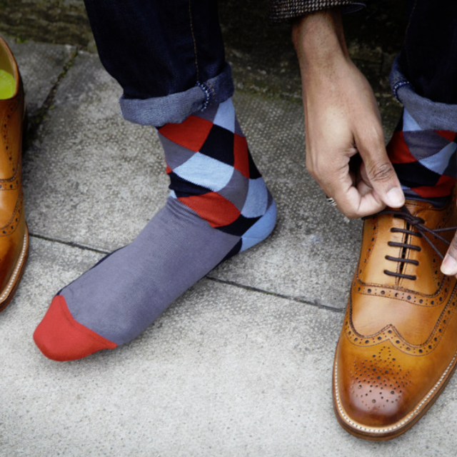
ASU’s
Ensure proper fit
Clean & Pressed
Remove all loose thread
Shoes Polished
Avoid colorful socks/undershirts

Slide 7
Female ASU, courtesy of https://www.garrison.hawaii.army.mil/dptms/tv2.htm

Slide 8
Male ASU courtesy of https://www.garrison.hawaii.army.mil/dptms/tv2.htm

Slide 9
ASU’s
The jacket should fit squarely on the shoulders
The sleeves should extend to the proximal MCP when arms at your side
The coat should extend to the hip when standing
The collar of the white shirt should have space for 2 fingers only

Slide 10
ASU’s
Pants should be tailored so that cuffs break on top of shoes
Belts are always threaded through left loops first, adjust length so that brass tab extends through buckle without exposing blue fabric
This is a guide some people have found helpful
https://www.amazon.com/U-S-Army-Uniform-Guide-Sharp/dp/B00B0YEFRY/ref=sr_1_1?ie=UTF8&qid=1491958602&sr=8-1&keywords=army+uniform+guide

Slide 11
ACU’s/OCP’s
Remove loose thread
Not too big, not too small
Tuck in your pant legs, Fasten pant legs with elastic strap
Button all buttons on the uniform, Zip up all zippers
Tuck in your laces
I prefer to square knot my laces after wrapping them around my boot tops and tucking into the boot.

Slide 12
ACU’s/OCP’s
Always wear your hat (cover) outdoors
Unit patch is worn on the left shoulder
Name tapes over right breast pocket, back of cover
US Army Tape over left breast pocket to keep your country close to your heart.
American flag should always have the field of stars facing forward
Right sleeve, should not be subdued

Slide 13
PT’s
You can wear black or white socks without logos showing
Socks should be above the ankle and below the knee
Get a reflective belt, they will want you to have one
Ask what the uniform is for the test in winter sometimes its full PT’s including jacket and sweat pants. In summer it is usually just the short sleeve t-shirt and shorts. I bring the jacket with me even in summer to store wallet and keys.

Slide 14
Hair Cuts & Grooming
Get a fresh haircut before interviews
Sideburns should extend to no lower than the opening of the ear
Shave every morning or prior to every shift
I advise against a mustache for men, but if you must, ensure that it is tapered and does not extend past the corner of the mouth
Ladies must have hair that does not fall past the shoulders if not worn in a bun.
Hair ties must be subdued, natural color (brown, tan, etc)
Clear fingernail polish only
For further questions reference below
http://www.armyg1.army.mil/hr/uniform/docs/uniform/Female_Grooming_Standards.pdf

Slide 15
Bags, Sunglasses, Ear devices
Black must be black or match the uniform you are wearing if shoulder strapped
Brief cases messenger bags may be leather
Logos must be subdued or blacked out while in uniform
Sunglasses must be black with smoke lenses, no mirror lenses, or other colored lenses
Do not wear sunglasses on your head or hat
Do not walk around with a blue tooth or ear buds in your ear while in uniform, you may drive with ear buds or a blue tooth in your ear.

Slide 16
NAVY

Slide 17
Navy Uniform Guidelines
Female Officer Uniform Guidelines: http://www.public.navy.mil/bupers-npc/support/uniforms/uniformregulations/chapter3/FemaleOfficer/Pages/default.aspx
Male Officer Uniform Guidelines:
http://www.public.navy.mil/bupers-npc/support/uniforms/uniformregulations/chapter3/MaleOfficer/Pages/default.aspx

Slide 18
Navy Uniforms - When to Wear?
Dress Blues and Dress Whites
Interview Day, Graduation, weddings, formal events
Generally wear blues in the fall/winter, whites in the spring summer; if you only own one versus the other, ask your command if they are flexible
Khakis/Summer Whites (Service Uniforms)
In clinic can always wear khakis
Fridays at most Navy hospitals require Khakis instead of NWUs if in clinic
NWUs
Military training simulations
Monday – Thursday in the hospital when on clinics that require uniforms
Scrubs
On Shift/Cadaver Lab/Medical training where you may encounter blood/fluids
PT’s
For a PT test, at the gym

Slide 19
Navy Dress Uniforms – Blues and Whites
Generally dictated by command when to wear whites versus blues, or by the season of the year
Women’s cover changing to “unisex” combo cover, obligatory by 2018; women may still wear their women’s only cover until that time
Women’s white dress top also changing to “choker” style; may purchase now at your large NEXs
Female Guidelines: http://www.public.navy.mil/bupers-npc/support/uniforms/uniformregulations/chapter3/FemaleOfficer/FO_ServiceDress/Pages/default.aspx
Male Guidelines: http://www.public.navy.mil/bupers-npc/support/uniforms/uniformregulations/chapter3/MaleOfficer/MO_ServiceDress/Pages/default.aspx

Slide 20
Navy Khakis/Whites (Service Uniforms)
Ensure proper fit (see guidelines)
Clean & pressed with creases at all times
Remove all loose threads
Shoes Polished
Black/Brown socks to match shoes while in khakis, white socks while in white uniform
White undershirts always
Khakis: http://www.public.navy.mil/bupers-npc/support/uniforms/uniformregulations/chapter3/MaleOfficer/MO_Service/Pages/ServiceKhaki.aspx
Whites: http://www.public.navy.mil/bupers-npc/support/uniforms/uniformregulations/chapter3/FemaleOfficer/FO_Service/Pages/FO_SummerWhite.aspx

Slide 21
NWUs
Two uniforms allowed currently – “blues” and “greens” type 3; swapping over to “greens” circa 2017/2018, however they are unavailable to purchase at this time unless you are authorized
Suggestion is to not purchase anything you absolutely do not have to for your blues at this time, and await future orders on when/where to purchase greens
Male Guidelines: http://www.public.navy.mil/bupers-npc/support/uniforms/uniformregulations/chapter3/MaleOfficer/MO_Working/Pages/default.aspx
Female Guidelines: http://www.public.navy.mil/bupers-npc/support/uniforms/uniformregulations/chapter3/FemaleOfficer/FO_Working/Pages/default.aspx

Slide 22
NWUs
Remove loose threads
Not too big, not too small
Tuck in your pant legs, Fasten pant legs with elastic strap/tuck in pant legs to boots
Sleeves up or down is dictated by your command as well as the season
Tuck in your laces
“Coveralls” are a working uniform as well; reserved for special units/jobs; interns for the most part will not utilize this uniform option

Slide 23
Navy - PT’s
You can wear black or white socks without logos showing
Socks should be above the ankle and below the knee
Get a reflective belt, they will want you to have one
May have in single earbud when doing PT or running outside for safety purposes
Ask what the uniform is for the test in winter sometimes its full PT’s including sweatshirt/hoodie and sweat pants; in summer it is usually just the short sleeve t-shirt and shorts

Slide 24
Navy - Hair Cuts & Grooming
Get a fresh haircut before interviews
Sideburns should extend to no lower than the opening of the ear
Shave every morning or prior to every shift
I advise against a mustache for men, but if you must, ensure that it is tapered and does not extend past the corner of the mouth
Ladies must have hair that does not fall past the shoulders if not worn in a bun
Avoid brightly colored fingernail polish; must be “complementary” to skin tone
Additional Information: http://www.public.navy.mil/bupers-npc/support/uniforms/uniformregulations/chapter2/Pages/default.aspx

Slide 25
Navy - Bags, Sunglasses, Ear devices
Bag must match the color of your uniform
For instance, if in whites, must have entirely white purse/bag without insignia or brands showing
If in “blues,” bag must be black
Backpacks (all black) okay with khaki service uniforms and NWUs only; briefcases or purses with dress uniforms
Gold earrings for women only unless in Dinner Dress – may wear pearls
Logos must be subdued or blacked out while in uniform
Don’t wear sunglasses on your head or hat
Do not walk around with a blue tooth or ear buds in your ear while in uniform; though may utilize single earbud while participating in PRT

Slide 26
Air Force
See AFI36-2903 for the full text

Slide 27
Air Force Outline
When to where
Airman Battle Uniform (ABUs)
Service Dress
Blues
Blues and Service Dress Flight Cap
Physical Training Gear
Hair and Grooming
Bags, Sunglasses, Jewelry, and Earbuds

Slide 28
Air Force – When to where?
Wear the uniform of the day (UOD)
Usually Blues for patient facing admin duties
Otherwise, Airman Battle Uniform (ABU)
Scrubs as required for work (there is a section of AFI36-2903 about these)
Flight Suits for flying duties – probably N/A unless 48G/R AFSC’s
Service Dress when in trouble, or interviewing
Physical Training Gear (PTG) during mandatory physical training formations
Always wear a cover outside (except Mess Dress and PTG)

Slide 29
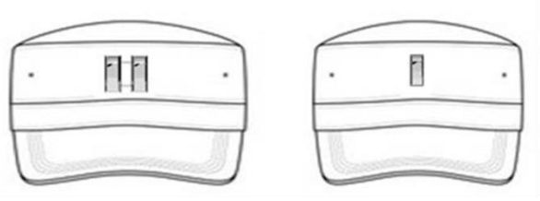
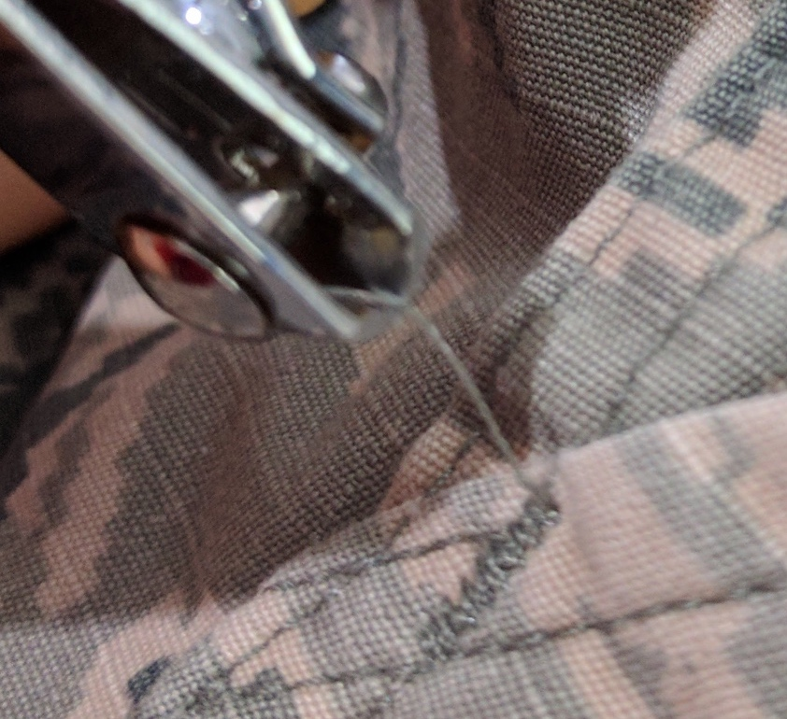
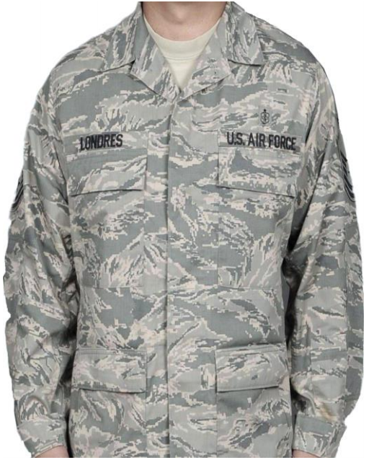
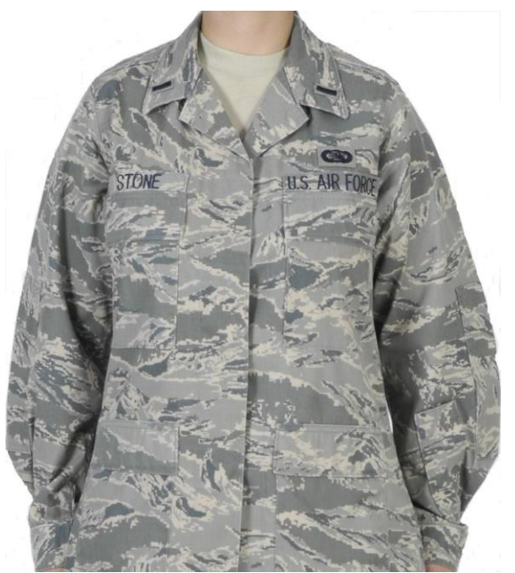
Air Force – Airman Battle Uniform (ABU)
Rank – subdued metal or cloth
Undershirt
Desert tan/sand T-shirt
Friday morale shirts per local policy
Button all of your pockets
Patrol cap
Rank can be subdued metal or cloth
Bottom edge should be parallel to the ground
Black or sage green beanie in cold weather is authorized – no rank worn
Outerwear
Rank on fleece (velcro) and APECS (loop in front epaulet)
Velcro name and AIR FORCE tape for fleece (Air Force is on you heart, i.e. to the right)
Trim you cables - your NCOs and Airmen are judging you
Blouse your boots or tuck pant legs into boots
Wear a tan web belt
Cable
Notes:
Page 91 of AF36-2903 has information about watch caps (beanies)

Slide 30
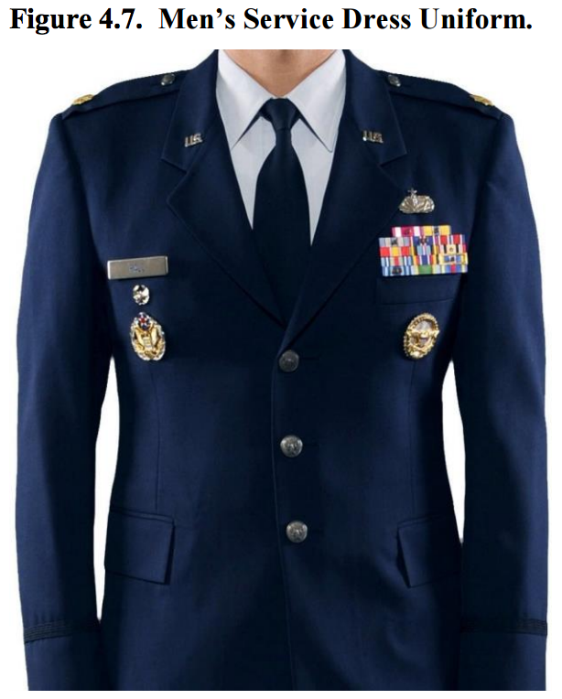
Air Force Service Dress – Male & Female
Rank
Centered 5/8 inches from the end of the epaulet
Long edge of rank is parallel to the seam (thick part of Captain’s bars are parallel to seam)
“U.S. insignia” (no circles for officers)
Rest halfway up the lapel seam
Parallel to the ground, without overlapping the seam
Name tag
Silver (not blue)
Centered over right mid-clavicular (since the Air Force is always on your heart)
Bottom edge of the name tag should be parallel to the bottom edge of the ribbons
Notes:
Medical Corps (MC) badge used to be mandatory, so you might get called out for not wearing one
Medical Service Corps is optional

Slide 31
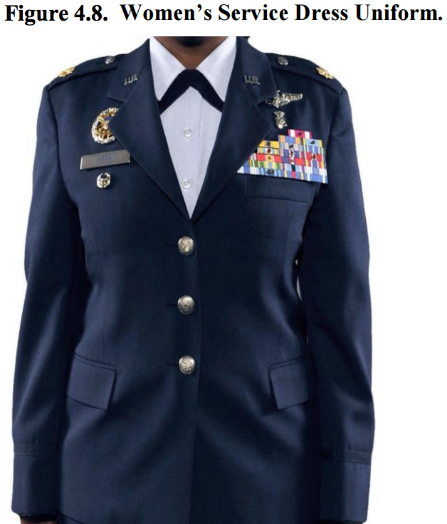
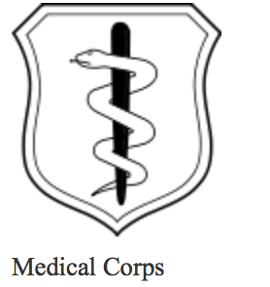
Air Force Service Dress – Male & Female
Ribbons – required on service dress
Bottom edge of rack meets the edge of the welt pocket without overlapping
See AFI36-2903 for ribbon priority
Specialty badge – medical badges are optional
Centered 0.5 inches above the highest ribbon
Only aeronautical and chaplains are required
Medical students are MSC, graduated physicians are MC
Doctors
Students
Notes:
Medical Corps (MC) badge used to be mandatory, so you might get called out for not wearing one
Medical Service Corps is optional

Slide 32
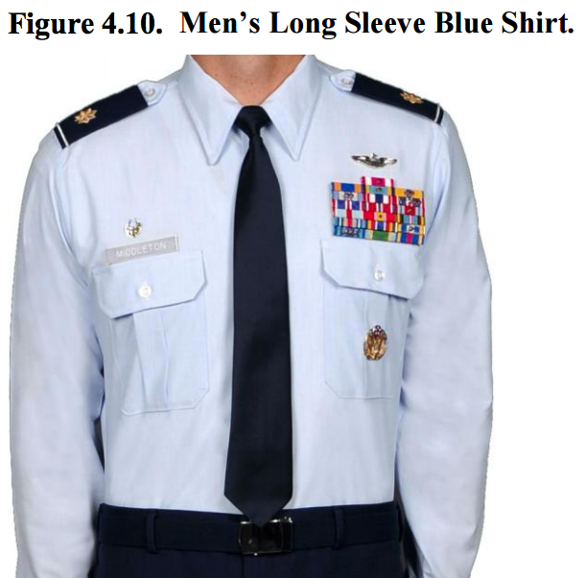
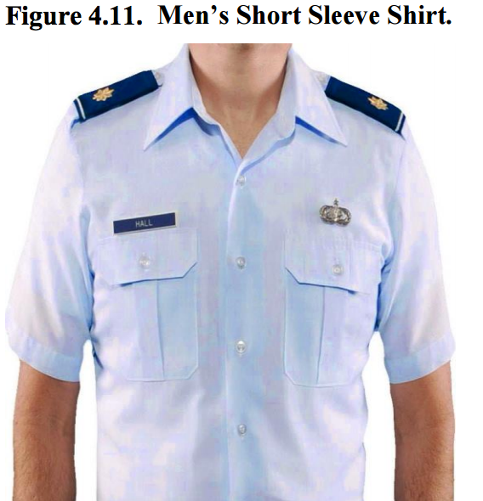
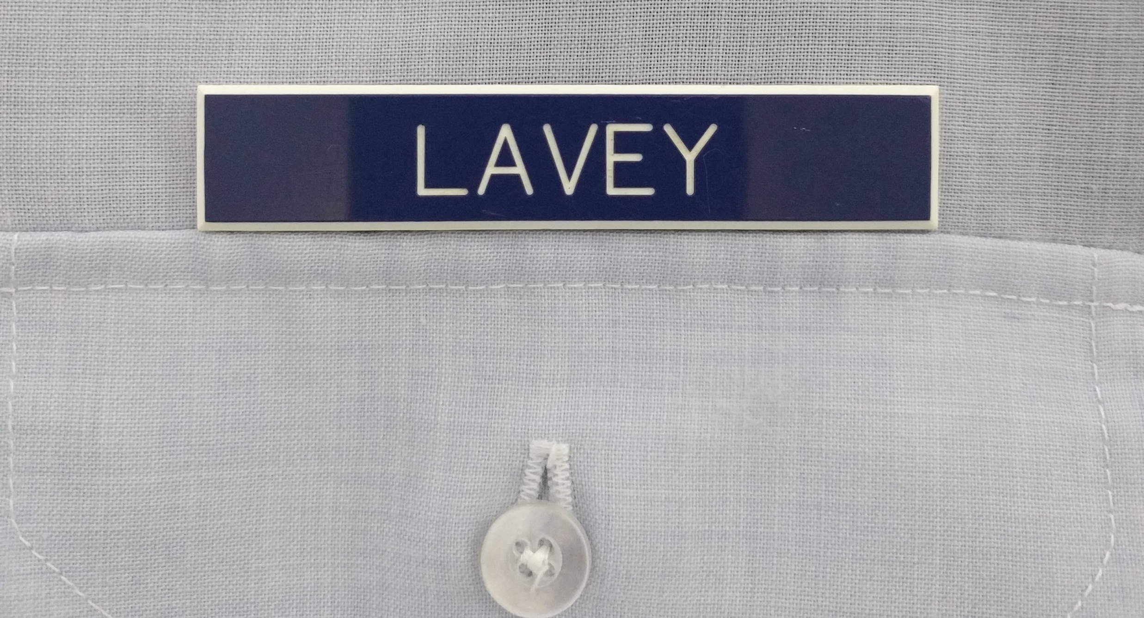
Air Force Blues – Men’s
White undershirt required – shouldn’t be visible at collar
Wear black dress socks
Always wear men’s (larger) shoulder board rank
Shine your shoes – black with rounded (not square) toes
Blue plastic engraved name tag – do not overlap right pocket
Ribbons – optional – officers usually don’t wear these
Bottom edge of rack meets the edge of the pocket without overlapping
See AFI36-2903 for ribbon priority
Should be centered

Slide 33
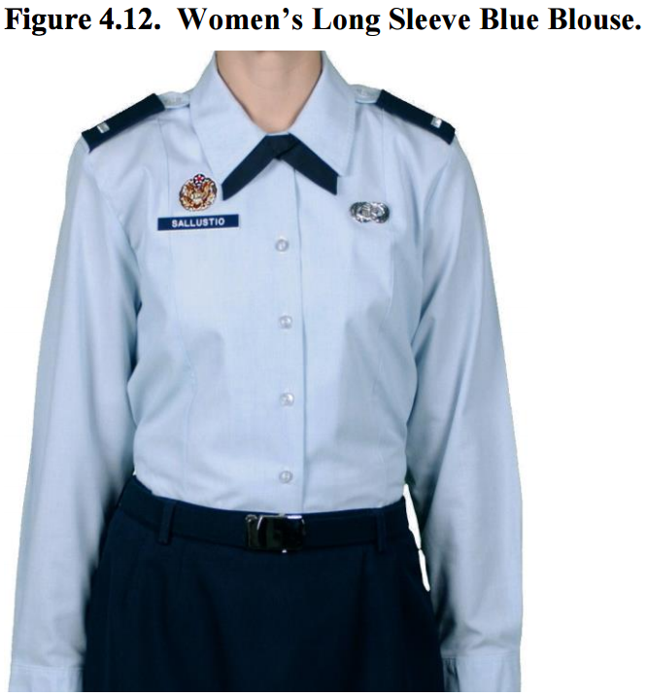
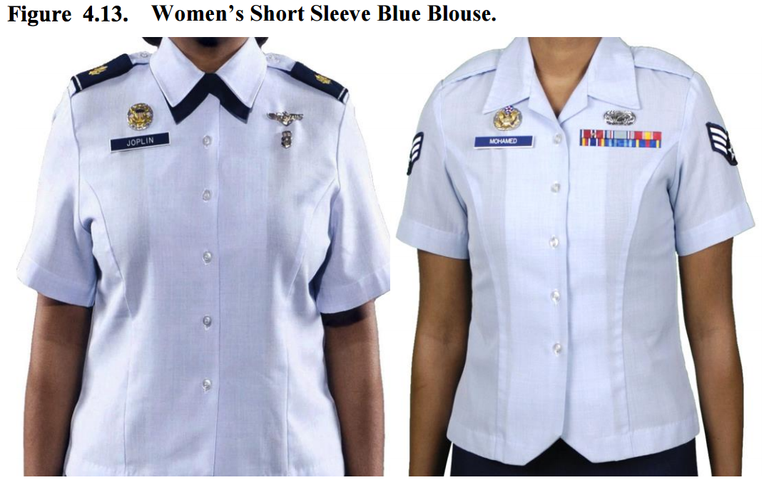
Air Force Blues - Women’s
+/- 1.5 inches
Princess cut does not need to be tucked in (not pictured)
Black dress socks with slacks
Skin toned hosiery with skirts
Name tag
+/- 1.5 inches of first exposed button
Centered on right mid-clavicular
Footwear – shined black leather or patent
Low quarters
Pumps
Less than 2.5 inch heel
Greater than 0.5 inch diameter at tip
Princess cut

Slide 34
Air Force Blues - Women’s
Undershirt – must wear white shirt that is not visible at the collar
Shoulder board rank is smaller than male’s rank
Name tag – blue engraved plastic – do not overlap right pocket
Ribbons – optional – officers usually don’t wear these
Tie tab is optional with short sleeves

Slide 35
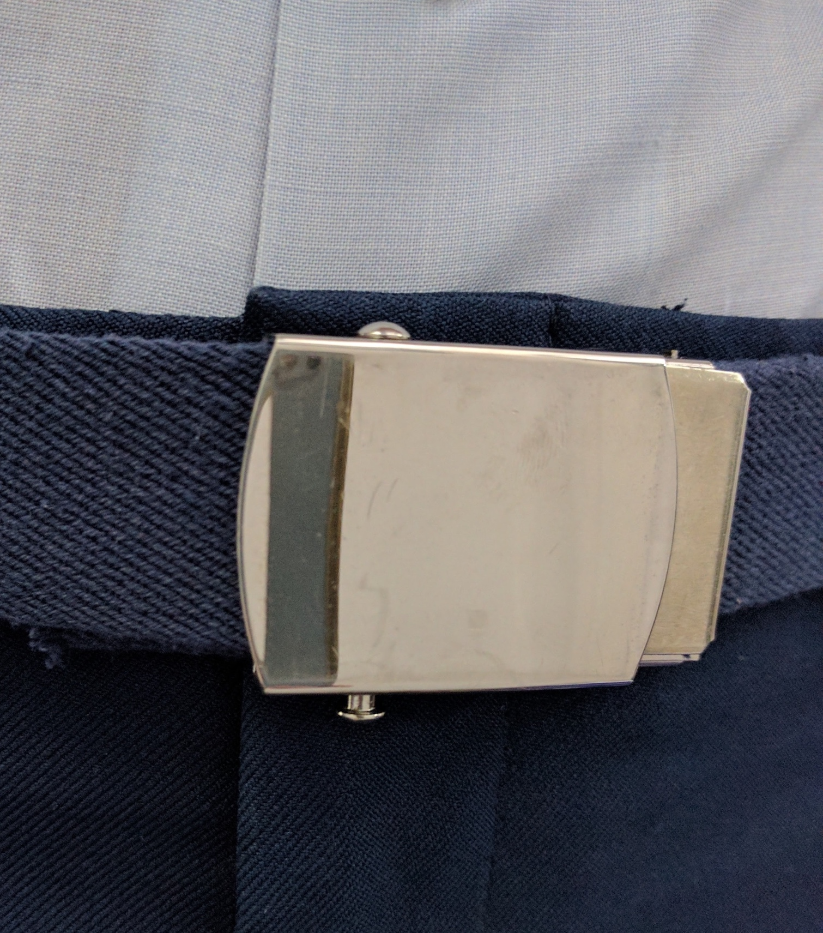
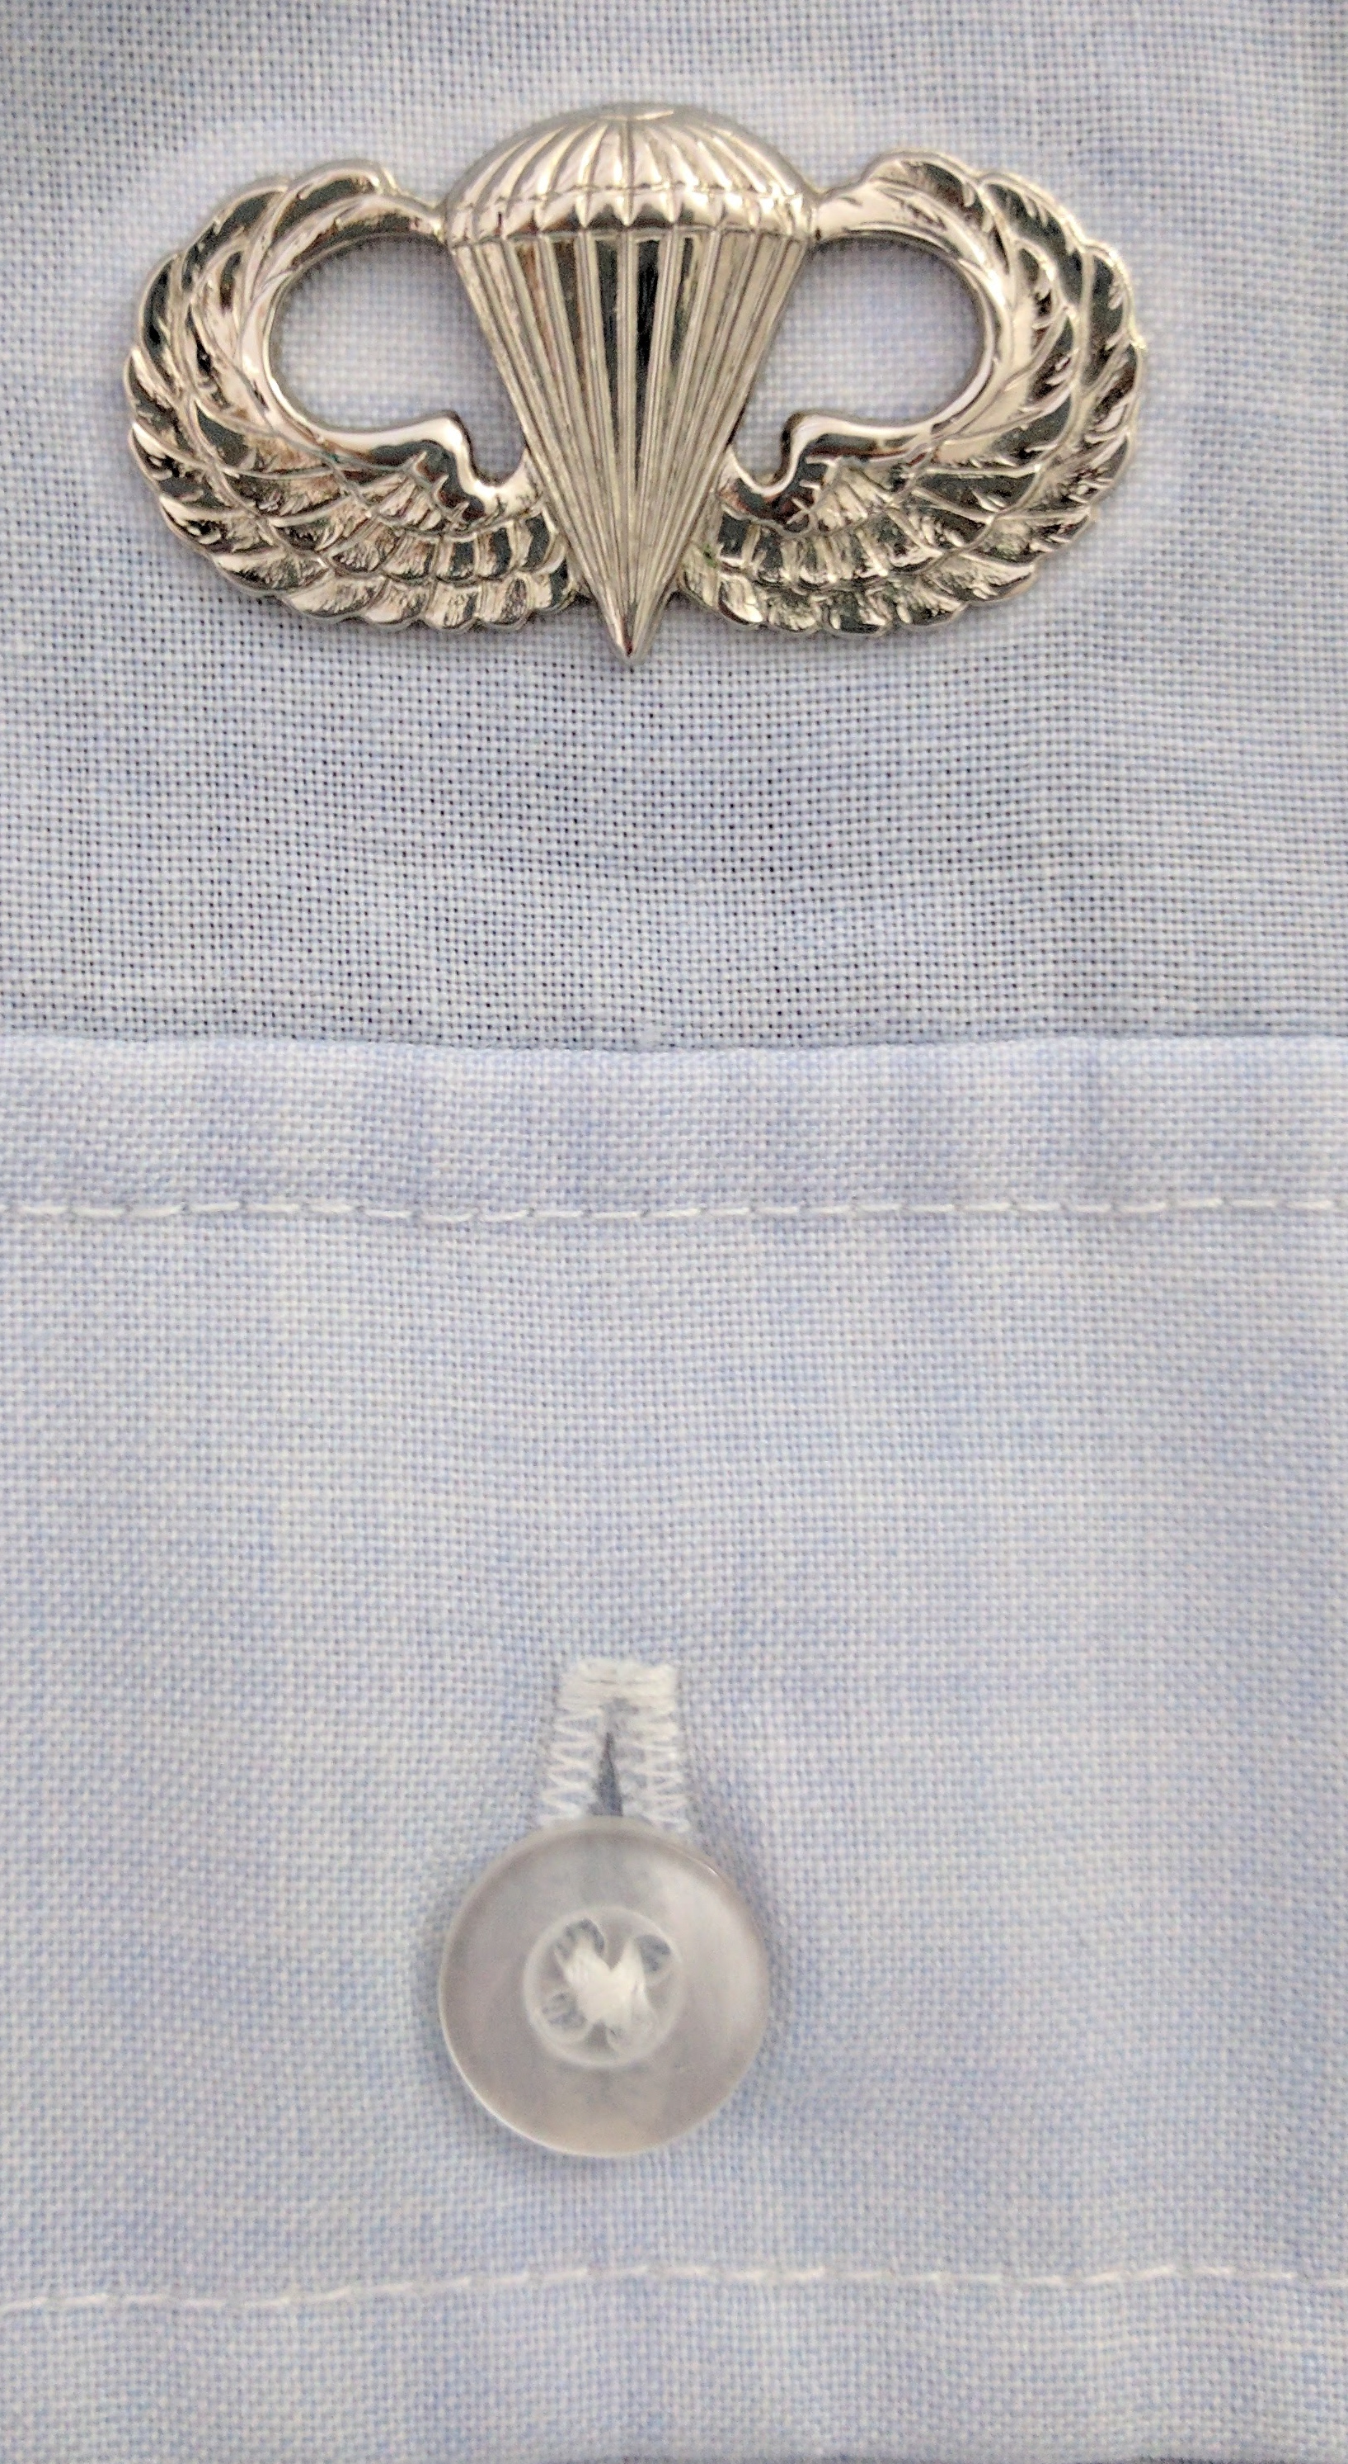
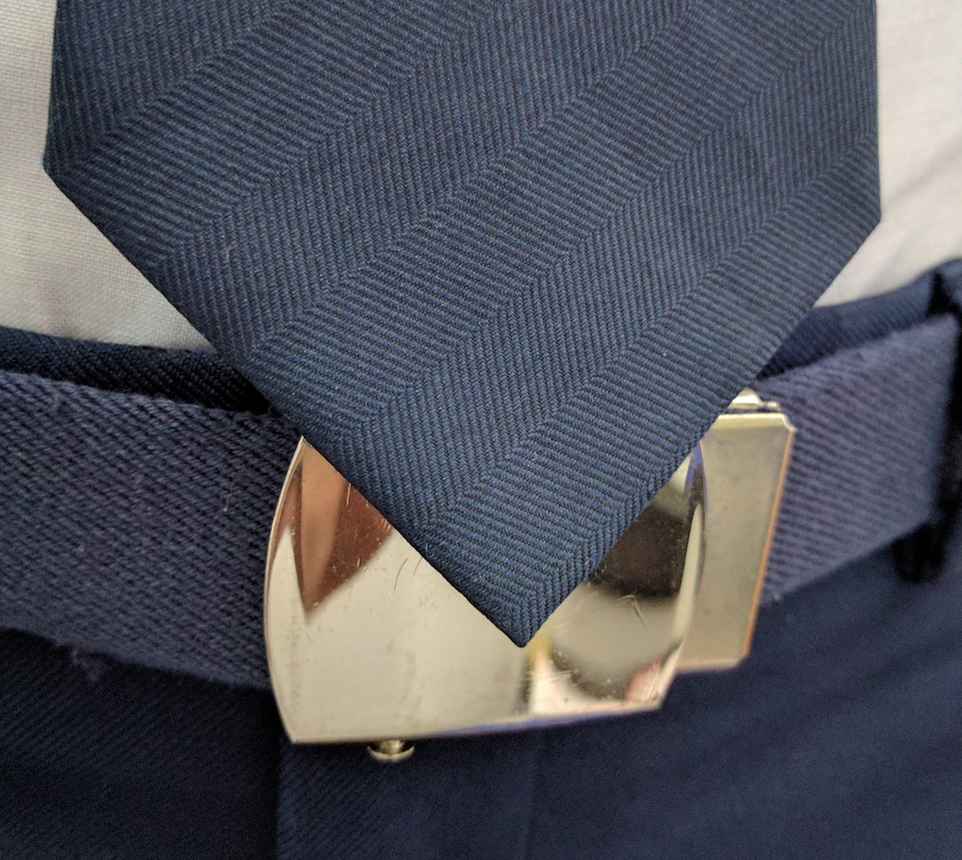
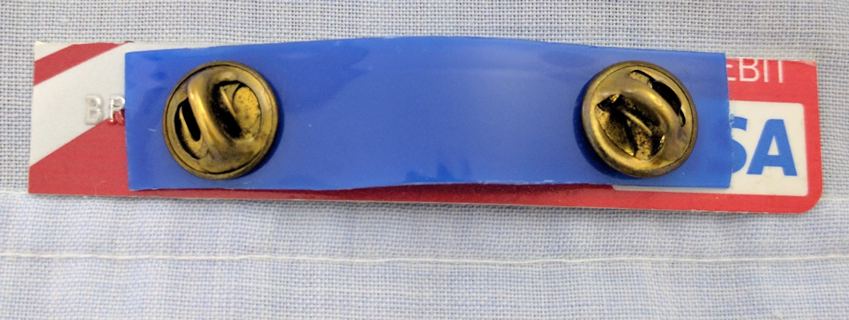
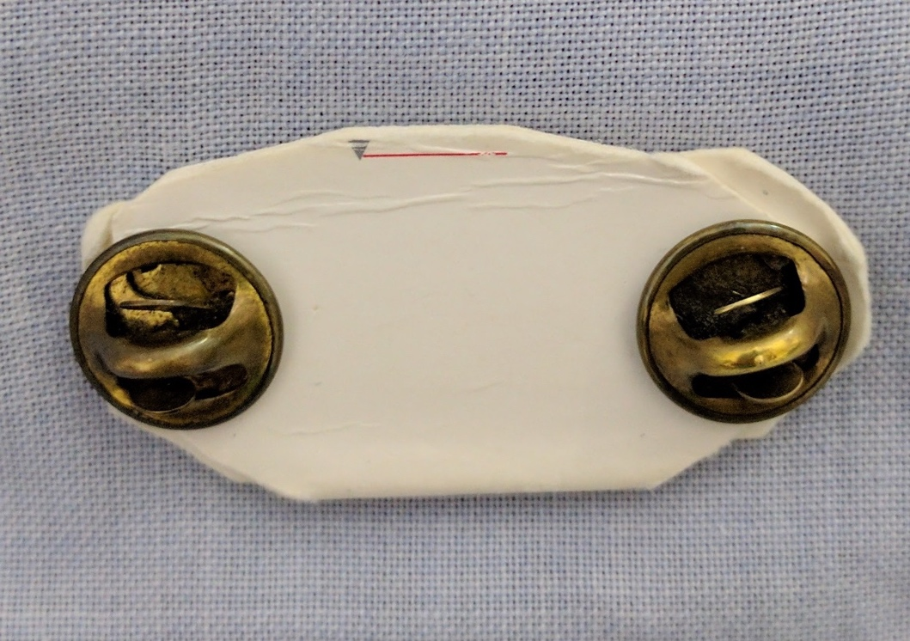
Air Force Blues
Gig line
Use backing on name tags and badges
Old credit cards, cardboard, starch can lids
Watch you gig line – shirt, fly, and belt should form one line
Specialty badge – medical badges are optional – center 0.5 inches above left pocket
Only aeronautical and chaplains are required
Medical students are MSC, graduated physicians are MC
Ties optional with short sleeves, required with long sleeves
Tie should end at mid-belt buckle when at attention (next slide)
Tie tab and cuff links are optional (use the uniform tab/links)
0.5 inches
Back of nametag

Slide 36
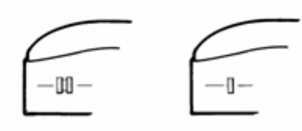
Air Force Blues and Service Dress Flight Cap
Officer flight cap has a blue and silver braid
Rank
Satin metal (not subdued)
Centered 1.5 inches from the front edge
Left aspect of cap
Men’s cap
1.5 inches
centered
Women’s cap
Right aspect of men’s officer flight cap
Notes:
Enlisted flight cap has a solid blue braid
General officers have a solid silver braid

Slide 37
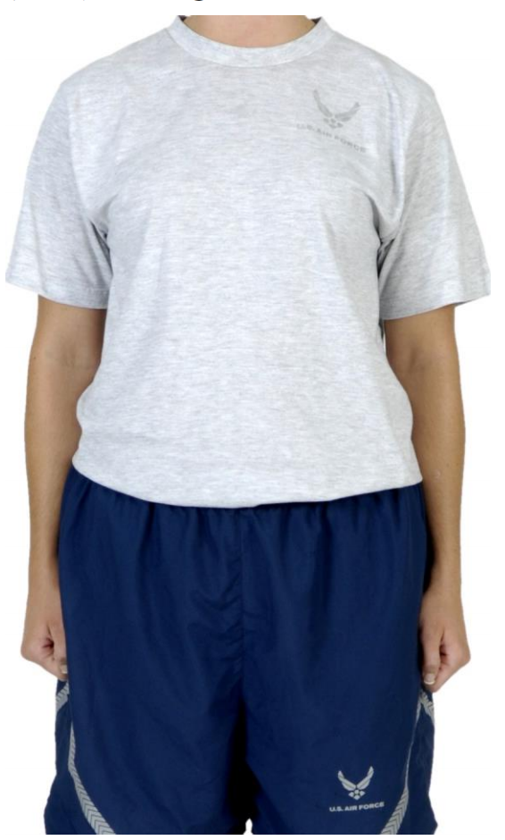
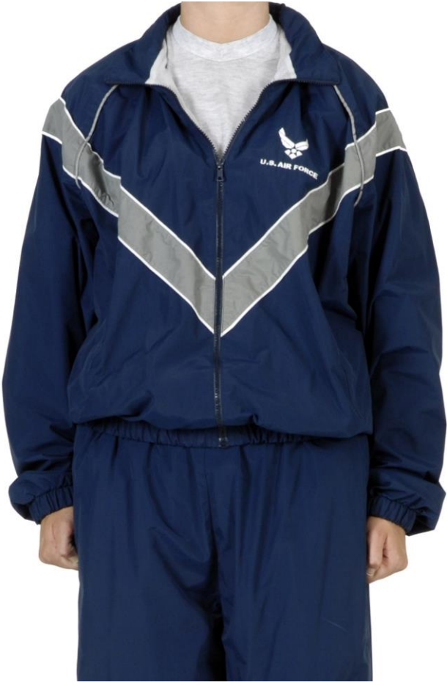
Air Force – Physical Training Gear (PTG)
We’re not the Army – reflective belts are optional unless local policy says otherwise
Black socks are cool, so are white socks. Small logos are okay
Always tuck your shirt
Don’t roll your sleeves
Must be zipped above halfway between the waist and collar
White or light gray undershirts can be visible
Undergarments are required, even with the shorts that have mesh liner
Liner can be removed
Short, mid, or full length spandex in solid black or dark blue can be worn
Headphones are authorized in fitness centers and some running areas, however local policy can restrict this
Saluting
No need to salute people, due to no rank on uniforms
Salute during taps, reveille, or other customary times
Notes:
Side note, black socks used to be against the rules until about 2013-2014. Wear black socks and drive your NCOs nuts, but it’s okay since black socks are allowed now

Slide 38
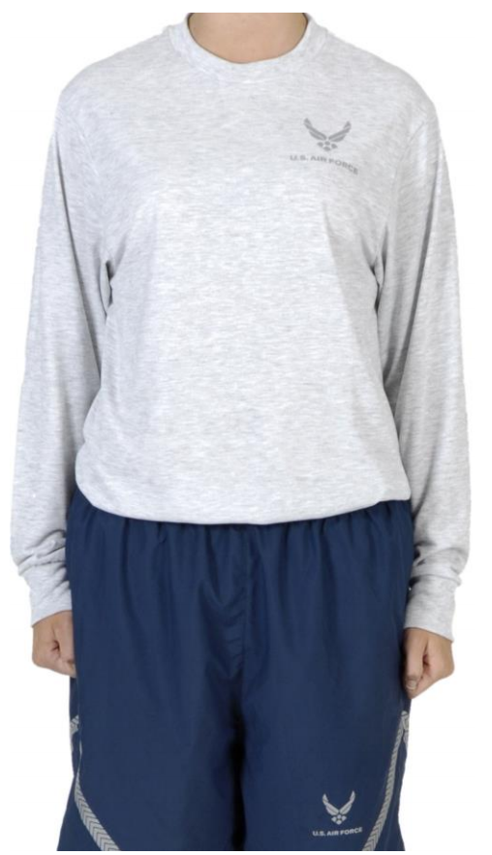
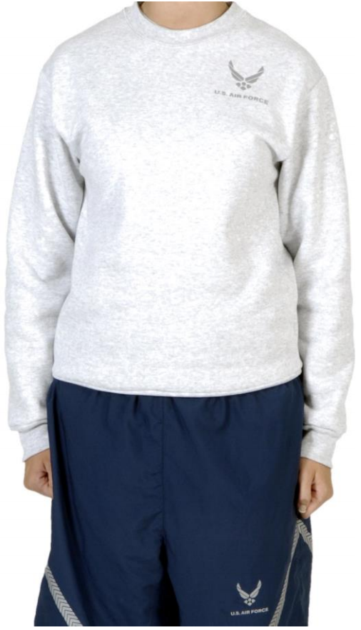
Air Force – Physical Training Gear (PTG)
Optional uniforms
Notes:
Side note, black socks used to be against the rules until about 2013-2014. Wear black socks and drive your NCOs nuts, but it’s okay since black socks are allowed now

Slide 39
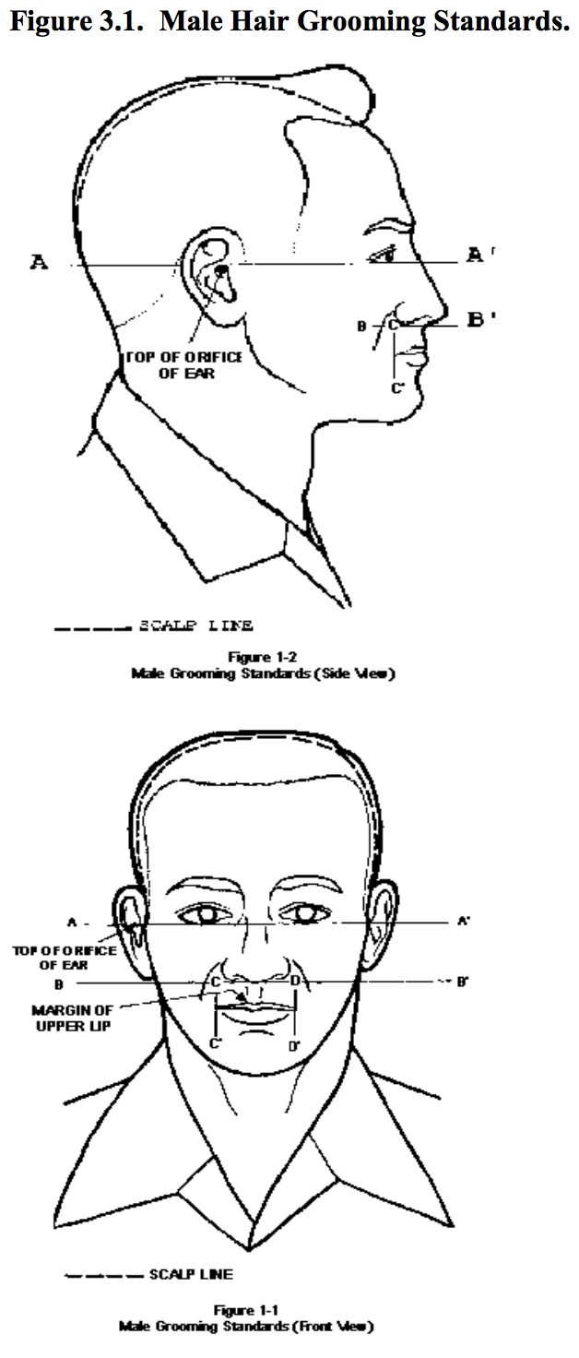
Air Force – Hair and Grooming
1.25 inches in bulk, there is no rule on length
Tapered appearance, 0.25 inch at termination
Don’t let it touch your ears or collar
Sideburns are straight & end at the bottom of the auditory canal
Bangs can’t touch eyebrows, and shouldn’t be visible under the front head band of covers (headgear)
Mustaches (look up toothbrush mustache) must fit inside the area outlined by ‘BCD’ in figure 1-1
Can’t go past lateral edges of the lip, or grow beyond the vermillion border
Allowed per regulation, however only acceptable for officers during March, or while deployed
Beards, cosmetics, nail polish, earrings – nope
Notes:
Figures from AFI36-2903 http://static.e-publishing.af.mil/production/1/af_a1/publication/afi36-2903/afi36-2903.pdf

Slide 40
Air Force – Female Hair and Grooming
Minimum length 0.25 inches
Max bulk 3 inches from scalp
Hair must above the plane created by the bottom edge of the collar (in PTG, hair may extend beyond the collar)
Bangs can’t touch the eyebrows
No loose ends or fly-aways
Accessories must match hair color and can’t be ornamental
Hair color should appear natural
See AFI36-2903 for braids
Notes:
http://static.e-publishing.af.mil/production/1/af_a1/publication/afi36-2903/afi36-2903.pdf

Slide 41
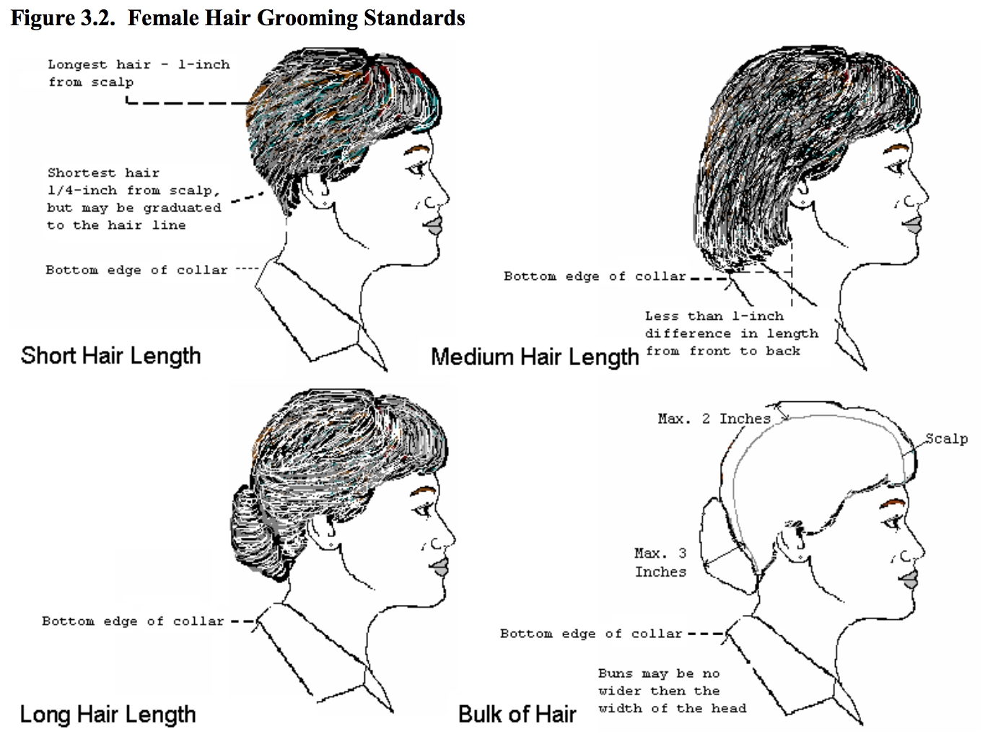
Notes:
Figures from AFI36-2903 http://static.e-publishing.af.mil/production/1/af_a1/publication/afi36-2903/afi36-2903.pdf

Slide 42
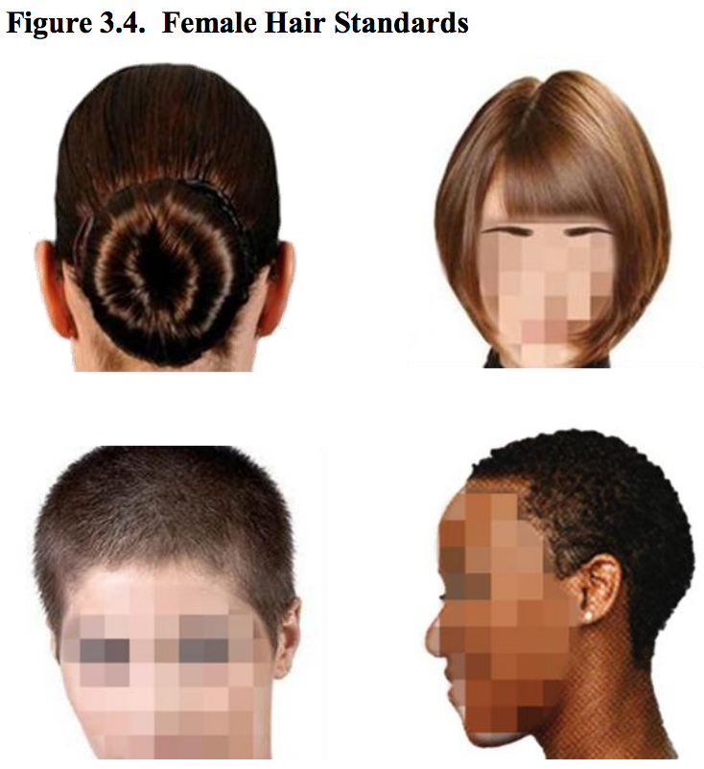
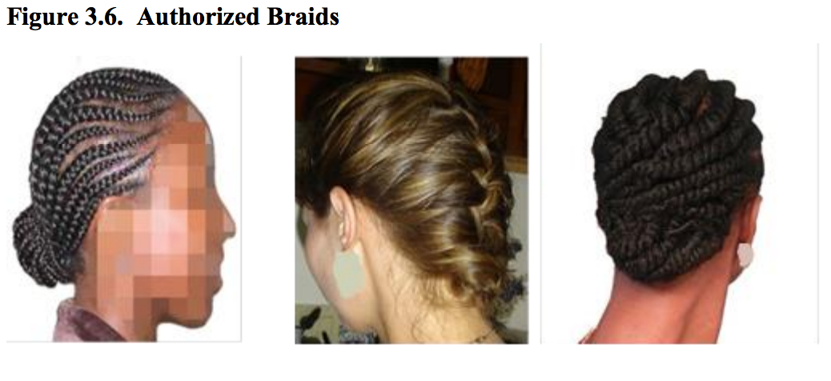

Slide 43
Air Force – Female Hair and Grooming
Fingernails
One tone or white French tips, no designs or multitonal
Colors cannot be extreme or bright
Less than 0.25 inches in length (male and female)
Must not interfere with duties
Cosmetics – no bright colors or extreme looks
Notes:
http://static.e-publishing.af.mil/production/1/af_a1/publication/afi36-2903/afi36-2903.pdf

Slide 44
Air Force – Bags
Backpack
Small logos are allowed
In ABUs – Black, olive drab, sage green, or ABU pattern
In Blues – solid black only
One or both shoulders – must not interfere with saluting
Gym bag
Solid dark-blue, black, olive drab, sage green, or ABU pattern
Carried in left hand
Must not interfere with saluting
Handbags – solid black leather or vinyl
Up to two strap
With or without buckles
13x9x4.5 inch dimensions
Clutch – solid black leather or manmade, must be between 5x8 to 6.5x11 inches

Slide 45
Air Force – Sunglasses
Frames may be black or brown material or gold or silver wire
No faddish styles or mirrored lenses
Clear, slightly tinted, or photosensitive lenses are authorized
No sunglasses in formation (except with doctors note)
Small logos are okay
No colored contacts

Slide 46
Air Force – Jewelry
Necklaces must be concealed under a collar or undershirt
Max 3 rings
Wedding set counts as 1
Not worn on thumb
Must be worn at base of finger
Watches
Only one watch, Less than 1 inch width
Conservative in color
Bracelets
No ankles bracelets
One allowed, less than 0.5 inch width
Silver, gold, or POW/MIA (colors vary) allowed
Earrings – females only
Less than 6 mm in diameter
Spherical, round white diamond, gold, white pearl, or silver earrings

Slide 47
Air Force – Earbuds
Not authorized while in uniform, indoors or outdoors
Except
For the execution of official duties
During travel on public transportation
While wearing the PTG during individual or personal PT in the fitness center or on designated running areas unless prohibited by the installation commander
While in uniform operating a motor vehicle if local policy permits

