Slide 1
Military/HPSP Medical School
&
Residency Match (EM)
Kyle Couperus, EM2 Madigan (Army), Alex Eye, GMO (Navy)
- Thank You to All Those Who Contributed -
Anna Waller, EM1 SAMMC (Air Force)
Lisa Mack, MSIV (Army)
Griff Curtis, MSIV (Army)
Shawn Curry, MSIV (Army)
Additional Information Obtained From ACEP HSPS Documents and Respective Authors
Disclaimer – All dates are approximate and need verification. This document is only meant to help present the big picture. Yearly Program specifics may vary widely, and require close attention to your HPSP advisors’ guidance.

Slide 2
Disclaimer
This document is meant to help provide overall understanding of HPSP, and how navigate the complex Residency Match Process, most specifically for Emergency Medicine. Note, as an HPSP recipient you are required to go through the Military Match - at times this does involve using civilian match processes such as ERAS. The dates and specifics do change year to year, and the Military process occurs before the civilian match – so be diligent! Hopefully this presentation will help you along the way.
The main writer of this document is from the ARMY – thus some of the charts are from this Branch – our apologies for this slight bias. The AF/NAVY contributors had extensive input and reviewed this document, in an attempt to provide information useful for all Branches. We hope you are surviving/enjoying medical school! You are the future of Military Medicine and we hope you continue to pursue a Career in Military Emergency Medicine!
The opinions or assertions contained here in are the private views of the authors and are not to be construed as official or reflecting the views of MAMC, or the Department of the Army, NAVY, AIR FORCE, or the Department of Defence. This brief is also not a recruiting modality. For recruiting information, please refer to your local recruiting station.

Slide 3
Overview
Key Differences Military Vs. Civilian
  Medical School
  Residency
  Attending
Med School Map what to do each year
Military Residency vs. Civilian Deferred?
What matters most to residencies?
How to Apply?
The Selection Process Explained
What if I don’t match?
Logistics of the ‘Paid Move’ to your Residency Location!

Slide 4
Must Know Terms
ADT = Paid Away Rotation. Non-ADT ‘Out of Pocket’ Away
MODS = Military GME Website. This is your hub to find residency programs – apply for ADT/Away Rotations, and much more.
Officer Training
ARMY: BOLC (Basic Officer Leadership Course)
NAVY: ODS (Office Development School)
Airforce: COT (Commissioned Officer Training)

Slide 5
Key Differences
Medical School
Residency
Attending

Slide 6
Key Differences: Medical School
“Am I in the Military?” YES!
Branch Specific Officer Training (Between 1st-2nd year)
Occasional PT(fitness) test
Early deadlines for USMLE scores, Residency Applications
‘Away Rotations’ in Military lingo (ADT) during 3rd-4th year almost mandatory (paid for)
Be aware for planning (weddings/etc) – Military Residencies start about 1 month earlier than Civilian.

Slide 7
Key Differences: Residency
Number of spots – Less in Military
  Pro: Fewer applicants, closer specialty group, some specialties may become attainable to a less competitive applicant.
  Con: Less spots to apply for, can make competitive specialties drastically ‘easier’ some years, and ‘harder’ others
Locations – Fewer locations
  Pro: Some great programs, certain specialties have considerable high grade programs, fewer interviews (the typical Civilian interview cycle varies widely but can include 20+ ($$), vs. military 4-5 at most, 2 of which are paid for).
  Con: Fewer specific geographic options
Application process – Interview rotation/away rotation MUCH more important, different application ‘process/dates’
  Pro: Paid Away rotations! You get a much better ‘evaluation/feel’ for the program you will attend. You find out where you match several months before civilian counterparts (unless deferred to a civilian program)
  Con: Requires you to choose your top ‘locations’ somewhat earlier, early dates for USMLE scores/applications/letters requires diligence
More financial comfort during residency compared with civilian
You are in the ARMY/NAVY/AIR FORCE! Working with great people, serving great people!

Slide 8
Key Differences: Attending
Pro’s
Practice setting and location vary widely – many opportunities to see/do things civilian doctors will most likely never experience.
No Loans to pay back!
Con’s
There are some less than desirable locations/positions.
Lower salary

Slide 9
Typical Army/Air Force Path
Medical School + Training
Residency
Multiple Career Paths
Operational
Academic
Etc
No Match
Transitional Year
No Match
Match
Fellowship
-Depends On
Need
Graduate Medical Officer (GMO)
Match

Slide 10
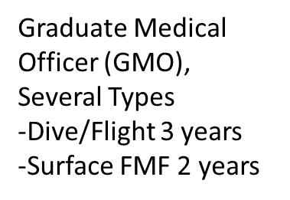
Typical Navy Path (2 Common Paths)
Medical School
Internship
Residency “Straight Through”
GMO
Fellowship
-Based on need
Multiple Career Paths
  Operational
  Academic
  Etc

Slide 11
Medical School Timelines
By Branch
ARMY
Navy
AIR FORCE

Slide 12
(ARMY) Med School → Residency Timeline
*ERAS App Due
9/15/2004
Disclaimer
-The year was arbitrary (made in 2016)
-Dates are approximated – but close – verify your year
-*ERAS/Civilian Match only for selected applicants
Programs Rank Students
11/5/2004
Match Results
12/16/2004
*Civilian Match
Schedule Away Rotations
3/17/2005
First Day Med School!
1/1/2004
First Day Military Residency!
8/15/2001
Rank List Due
Schedule BOLC
1/8/2002
10/15/2004
6/1/2005
2001
1st Year
2nd Year
3rd Year
4th Year
2005
Today
6/18/2003
11/1/2004
STEP 1
CS Exam
8/18/2004
STEP 2
34 days
BOLC
6/18/2002
8/4/2002
173 days
3/3/2004
Away Rotations
10/31/2004
47 days
Civilian Interviews
12/27/2004
3/1/2005
17 days
Moving/PCS
5/10/2005
6/1/2005

Slide 13
(Air Force) Med School → Residency Timeline
*ERAS App Due
9/15/2004
Disclaimer
-The year was arbitrary (made in 2016)
-Dates are approximated – but close – verify your year
-*ERAS/Civilian Match for ALL Air Force (limited ARMY)
Programs Rank Students
11/5/2004
Match Results
12/16/2004
*Civilian Match
Schedule Away Rotations
3/17/2005
First Day Med School!
1/1/2004
First Day Military Residency!
8/15/2001
Rank List Due
Schedule COT/AMP 101
1/8/2002
10/15/2004
6/1/2005
2001
1st Year
2nd Year
3rd Year
4thYear
2005
Today
6/18/2003
11/1/2004
STEP 1
CS Exam
8/18/2004
STEP 2
34 days
COT (+-) AMP101
6/18/2002
8/4/2002
173 days
3/3/2004
Away Rotations
10/31/2004
47 days
Civilian Interviews
12/27/2004
3/1/2005
17 days
Moving/PCS
5/10/2005
6/1/2005
30 days
*COT Early
6/16/2001
7/28/2001

Slide 14
(NAVY) Med School → Residency Timeline
Mil Rank List Due
10/15/2004
Disclaimer
-The year was arbitrary (made in 2016)
-Dates are approximated – but close – verify your year
-*ERAS/Civilian Match – Most Complete – Verify Your Year
Programs Rank Students
11/5/2004
Mil Match Results
12/16/2004
*Civilian Match
3/17/2005
First Day Med School!
First Day Military Residency!
8/15/2001
Schedule ODS
Schedule Away Rotations
1/8/2002
1/1/2004
6/1/2005
2001
1st Year
2nd Year
3rd Year
4th Year
2005
Today
6/18/2003
11/1/2004
STEP 1
CS Exam
9/15/2004
*Civilian App Due
8/18/2004
STEP 2
7/15/2004
ODS
Application Site Active
34 days
6/18/2002
8/4/2002
3/3/2004
Away Rotations
10/31/2004
173 days
Civilian Interviews
47 days
12/27/2004
3/1/2005
Moving/PCS
17 days
5/10/2005
6/1/2005
30 days

Slide 15
Year 1-4
Overall Military Related Goals Each Year
Branch Specific as Indicated

Slide 16
Year 1
All Branches
  Research?
    Added points on some Military residency application ‘score sheets’
ARMY
  Start preparations to take BOLC between First and Second Year (During Summer Break) - see following slides.
NAVY
  Start preparations to take ODS between First and Second Year (During Summer Break) - see following slides.
AIR FORCE
  Start Preparation to take COT (+/-) AMP 101 between Frist and Second Year (During Summer Break) – see following slides.

Slide 17
Year 1: BOLC - ARMY
BOLC (Basic Officer Leadership Course)
  Attempt to complete summer break between 1st and 2nd year
  6 Week course (I had a lot of fun – most do!)
    Try talking with somebody else who has already gone (Lots of practical advice)
  VERY hard to take later – but can be done
  Some recruiters pro-active, but sadly, this sort of falls on you –ask them or your HPSP adviser how to set it up.

Slide 18
Year 1: BOLC - ARMY
Setting up/Logistics
  Recruiters sometimes assist – they are the best place to start
  HPSP Counselor Wright/Simmons - they will help get you ‘Orders’ to BOLC (Apply on MODS)
  Recruiters can help obtain uniforms/ect from a nearby base, if not available can consider
    USAmilitarymedals.com or Marlowwhite.com/

Slide 19
Year 1: COT - Air Force
Commissioned Officer Training
  5 Week course in Montgomery Alabama at Maxwell Air Force Base
  Timing?
    Early Option: Can complete before medical school
    Or Between First and Second Year (Summer Break)
Aerospace Medicine Primary (AMP 101)
  2 Week Course at Wright-Patterson AFB in Dayton, Ohio
  2 Week introduction course to aerospace medicine (1st of three courses flight surgeons complete)
  Timing?
    Reportedly similar to COT, before medical school or between 1st and 2nd year.

Slide 20
Year 1: COT - Air Force
Logistics
  Please contact Air Force Institute of Technology (AFIT)

Slide 21
Year 1: ODS - NAVY
Officer Development School (ODS)
  5 Week Course in Newport, RI
  Timing?
    Early Option: Some people take before medical school
    Or Between First and Second Year (Summer Break)
    Or After medical school before starting Residency
Logistics
  Contact your Recruiter or HPSP Advisor

Slide 22
Year 2
All Branches
  USMLE Step 1 (end of second year)
    Score to HPSP office by ~September 15 of 3rd year
    Note: Some schools (Such as Columbia) have off cycle Step 1 testing, in this case a brief signed letter from the school will secure a deferment
  Research?

Slide 23
Year 3
All Branches
  Core Clinical Rotations
    Starting time varies by school
    Can complete ‘required’ rotations as a military ‘ADT’ i.e. away rotation
  Letters of Recommendation (3 min – 4 max)
    Start to ask: EM specific, consider SLOE/SLOR, EM standardized letters
  Start planning 4th Year Interview Rotations/ADTs (Army Away Rotations – more details later)
    December/Jan of 3rd year
    Contact information for programs on MODs/Online

Slide 24
Year 4
Away rotations/ADTs/Interview Rotations
  Very important
  Usually for the first parts of 4th year (June-October)…Can start earlier
  Logistics Described Later
Residency Application
  Military Specific: Initial App due by mid Sept, Rank List due by ~October 15th Through MODS website
  Civilian through ERAS (Civilian application site) ~Sept 15th
    See Branch Specifics on who needs both in ‘How To Apply’

Slide 25
What Do Residencies Look At?
  Away Rotations, ADTs (Active Duty Tours)
  Board Scores
  Grades (AOA)
  Interview
  Letters of Recommendation
  Deans Letter
  Personal Statements
  Research
  Volunteering/Interest Groups/AMA
  Make Weight/Past PT test – Limited (GME requirement to advance through residency)
In Relative order for E.M. though likely varies widely.

Slide 26
What Do Residencies Look At?
  Away Rotations, ADTs (Active Duty Tours), “Interview” rotations
  Board Scores
  Grades (AOA)
  Interview
  Letters of Recommendation
  Deans Letter
  Personal Statements
  Research
  Volunteering/Interest Groups/AMA
  Make Weight/Past PT test – Limited (GME requirement to advance through residency)

Slide 27
ADT/Away Rotations/Interview Rotations
ADTs in General
  Paid Away Rotations! You pay up front – with reimbursement
  Request Through MODS
  Number will depend on length of scholarship (1 per year of scholarship)
  Options
    Away rotations/audition rotations/Interview rotations
      Most people have ‘2’ for these one for 3rd and 4th year
    BOLC counts as 1
    At school ADT (extra pay – but uses a paid Away)

Slide 28
Away Rotations – Logistics
Easier for us than Civilian!
Figure out what specialty, Look at programs on MODS (Or search website for contact info)
Rotate where you want to go – and where a program exists
  If no spots available, can complete a rotation with an alternative specialty and try to pick up shifts/etc.
Arrange Rotation Dates with program coordinator at site
Request orders in MODS (If an ADT rotation vs. a Non-ADT)

Slide 29
Away Rotations – Logistics
ADT vs. Non-ADT
  ADT. Two Step. (1) Arrange with program. (2) Request Orders through MODS
    Reimbursed Lodging, per diem pay, travel, rental car (all varies)
      Via travel voucher – keep receipts – contact Counselor way before going to discuss arranging flights/ect
  Non-ADT. One Step. (1) Arrange with program
    Can complete unpaid rotations for almost any length of time (A few shifts or a whole month) allows face time and ability to see the program
    Arrange the same way – just tell program it is a ‘Non-ADT’
    Gives you a chance to ‘audition’ at more locations
    It will all be out-of-pocket cost

Slide 30
Away Rotations – Logistics
Start Requesting December – January of 3rd year (Scheduling EARLIER than Civilian)
  Spots fill up FAST
Schedule into 4th year Rotation Dates
  I recommend scheduling even if you don’t have your school schedule yet – i.e. can reschedule if you really need to.
Cannot have ‘ADT’ scheduled over Oct 1-15th
  Okay for Non-ADT during this time frame

Slide 31

Away/ADT – How To Set Up

Slide 32
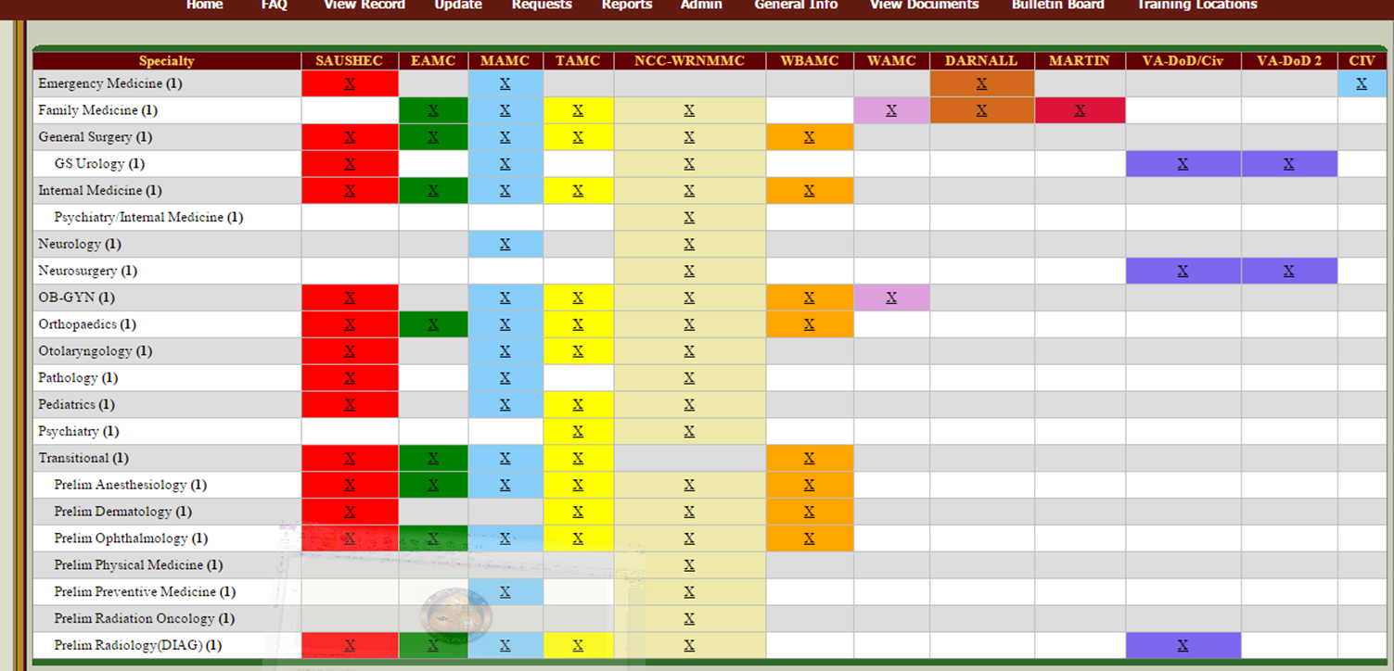
Away/ADT – How To Set Up

Slide 33
Audition Rotations Are
Very Important!
  The entire rotation is an audition. Residents and Attendings you work with => all have input.
    Go to the social events
    Work Hard, no phone, ask questions – be engaged – but don’t be mean to other students – it gets noticed
  You will usually formally interview during the rotation (Schedule during ADT)
    Often request via email prior to arrival
  Interview at all the places you did not rotate. In competitive specialties, face-to-face is a preferred. Less competitive might do with a phone interview
  If your specialty is a designated pre-select, you must also interview with all transitional programs linked to the site. (phone is fine)

Slide 34
What Do Residencies Look At?
  Away Rotations, ADTs (Active Duty Tours), “Interview” rotations
  Board Scores
  Grades (AOA)
  Interview
  Letters of Recommendation
  Deans Letter
  Personal Statements
  Research
  Volunteering/Interest Groups/AMA
  Make Weight/Past PT test – Limited (GME requirement to advance through residency)

Slide 35
Board Scores
Importance depends on specialty – and where you want to go
Can get a ballpark estimate of what you need based on Military GME data (On MODS after match/Google for the current year/ask recruiter)
Following slides are examples from 2011

Slide 36
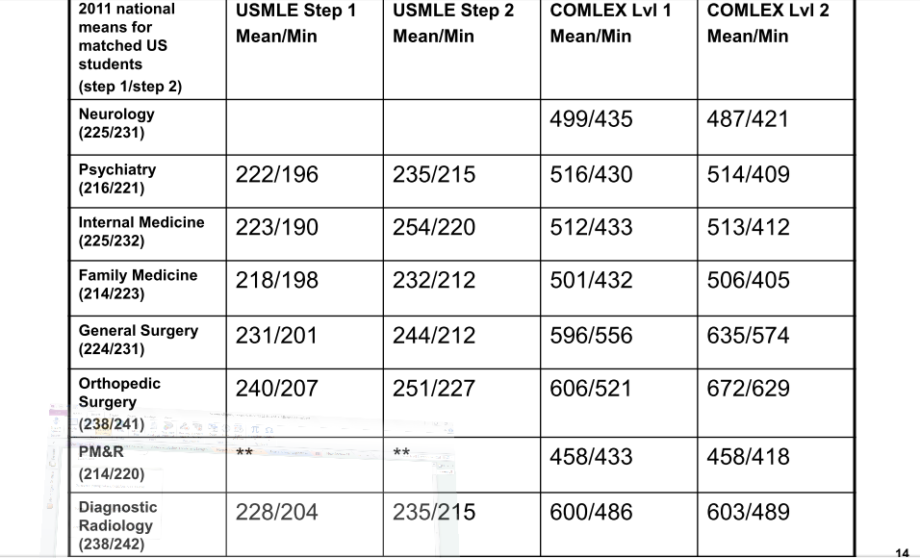

Slide 37
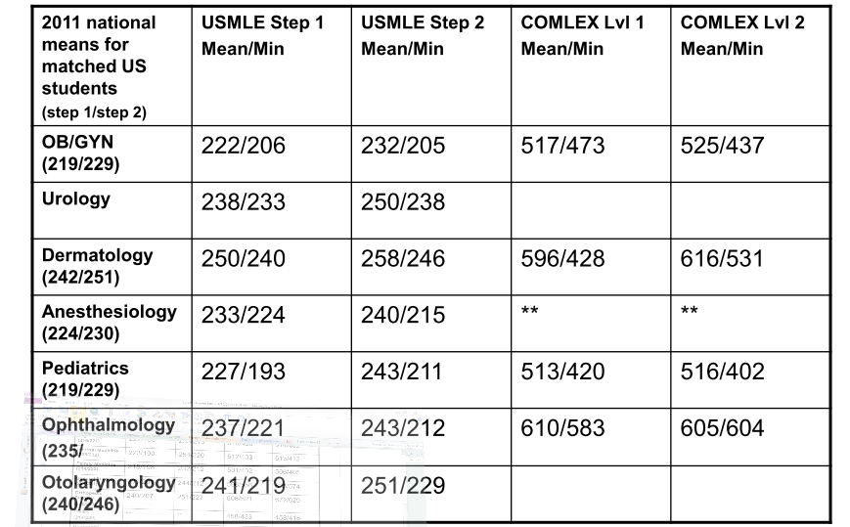

Slide 38
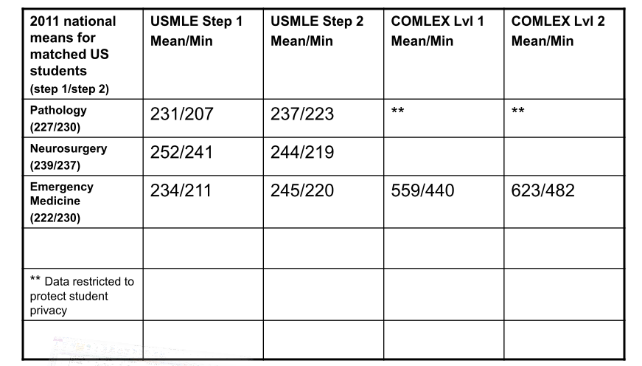

Slide 39
What Do Residencies Look At?
  Away Rotations, ADTs (Active Duty Tours), “Interview” rotations
  Board Scores
  Grades (AOA)
  Interview
  Letters of Recommendation
  Deans Letter
  Personal Statements
  Research
  Volunteering/Interest Groups/AMA
  Make Weight/Past PT test – Limited (GME requirement to advance through residency)

Slide 40
Grades/AOA
Doing well helps – but not an end all

Slide 41
What Do Residencies Look At?
  Away Rotations, ADTs (Active Duty Tours), “Interview” rotations
  Board Scores
  Grades (AOA)
  Interview
  Letters of Recommendation
  Deans Letter
  Personal Statements
  Research
  Volunteering/Interest Groups/AMA
  Make Weight/Past PT test – Limited (GME requirement to advance through residency)

Slide 42
Interview
Format Varies
  Usually complete during your ‘Away Rotation’ at that location
  Often meet with program directors, assistant program directors. Some are very formal, some by surprise
  “Tell me about yourself” some places have odd questions “who would you save if you were on a sinking ship”
  Review typical interview questions online
  Interview at all the places you did not rotate. Face to face is highly preferred but if unable - a phone interview is still better than nothing.

Slide 43
What Do Residencies Look At?
  Away Rotations, ADTs (Active Duty Tours), “Interview” rotations
  USMLE Board Scores
  Grades (AOA)
  Interview
  Letters of Recommendation
  Deans Letter
  Personal Statements
  Research
  Volunteering/Interest Groups/AMA
  Make Weight/Past PT test – Limited (GME requirement to advance through residency)

Slide 44
Letters or Recommendation
Get Letters during 3rd year, and during all away/ADT rotations.
  EM Specific SLOE/SLOR best, standardized letter from the whole department
  How to get a letter
    Initially just ask for a ‘good’ letter - they will expect you to contact them again in the future because it cannot be sent in until you start your residency application.
    Everybody will apply through MODS (+/-) ERAS(civilian residency application). In which case the site will open sometime 4th year Summer (Often Mid July), letters are Emailed to your HPSP advisor, or some Attendings can direct upload.
    ERAS applicants, FYGME Letter of Instruction (LOI) and Fact Sheet released to 4th year students in July (allows those letter to get sent in)
    For either – when an upload system is open, Re-contact those individuals ‘reminding’ them of some of the patients you saw/cases/etc and they can send your letter in with the appropriate form.

Slide 45
What Do Residencies Look At?
  Away Rotations, ADTs (Active Duty Tours), “Interview” rotations
  Board Scores
  Grades (AOA)
  Interview
  Letters of Recommendation
  Deans Letter
  Personal Statements
  Research
  Volunteering/Interest Groups/AMA
  Make Weight/Past PT test – Limited (GME requirement to advance through residency)

Slide 46
Deans Letter/Personal Statement
Deans Letter
  Meeting usually in 3rd year
  Review CV
  Compilation of comments from rotations
    Do well on rotations = good deans letter
Personal Statement
  Matters to varying degrees

Slide 47
What Do Residencies Look At?
  Away Rotations, ADTs (Active Duty Tours), “Interview” rotations
  Board Scores
  Grades (AOA)
  Interviews
  Letters of Recommendation
  Deans Letter
  Personal Statements
  Research
  Volunteering/Interest Groups/AMA
  Make Weight/Past PT test – Limited (GME requirement to advance through residency)

Slide 48
Research/Volunteering/Interest Groups
Dependent on specialty: Optho, Ortho, Derm – research may be the normal
For most
  Can help cover for less than optimal grades/board scores.
  I.e. If not as strong a candidate – these things can help.
PT Test
  Minimal effect – but helps to look the part, and will have a PT test during every ADT.

Slide 49
Military Residency Vs. Civilian Deferred/Sponsored
Civilian Deferred = Residency at Civilian Location.
Civilian Sponsored = Paid Military Wage, Residency at Civilian Location

Slide 50
Programs – Military
Vs.
Civilian Deferral
Over the Summer you will get an email detailing whether or not civilian deferrals will be granted and in what specialties. This may or may not be set in stone.
The likelihood of this varies by Branch, specialty, and swings widely year to year.
General: Some competitive residencies with limited spots will occasionally offer Civilian deferral based on army needs
*Important* every HPSP applicant must go through the Military Match Process – even if seeking deferment!

Slide 51
Civilian Deferral: EM Specific
EM Specific
  ARMY: Very unlikely to occur, in fact the ARMY has now indicated (as of 2016) ERAS (the hub of the civilian match) no longer needs to completed by any applicant except for Plastics and General Surgery. Follow the requirements of this closely.
  Air Force: Probably the most likely of the Branches to get a deferral, still seems best not to count on it. In addition, this MUST be completed concurrently THROUGH the Military Match process! The Program Directors help guide this process.
  Navy: Varies by year

Slide 52
How to Apply

Slide 53
How To Apply
A letter with detailed instructions is usually sent during your 3rd year. Follow that for specifics.
Currently
  The website known as “MODS” is the HUB for your application (ARMY, Air Force, & Navy)
  Application usually opens July of your 4th year
  All documents are sent/uploaded to MODS, endless also applying civilian (must also upload to ERAS)
  All documents are usually due around October 15th (including your rank list)

Slide 54
Branch Specifics – ERAS?
ARMY
  As of 2016, only those applying to Plastics and General Surgery ‘Had’ to complete MODS and ERAS
  Most applied for ‘specialty’ + a transitional year for last ranking
NAVY
  Depending on needs/direction may require ERAS
Air Force
  Applied to both MODS and ERAS
  Most applied for ‘Choice specialty’ (+/-) second specialty, plus a medicine year, a surgery year, and a transitional year for last ranking
- Important to check you year -

Slide 55
The Selection Process

Slide 56
EM Specific
Who are you ‘Competing’ with?
ARMY: Two Applicant Pools
  Medical Student
  Transitional Year + GMO
NAVY/AIR FORCE:
  All applicants in same group

Slide 57
EM Selection Process: ARMY
Slots
  Augusta: 6 MS (Varies), 2 TY/GMO
  Darnell: 8 MS, 2 TY/GMO
  Madigan: 10 MS, 2 TY/GMO
  San Antonio 6 MS, 2 TY/GMO
  Total: 30 MS, 8 TY/GMO

Slide 58
EM Selection Process: ARMY
Medical Students (MS)
  Students Rank 5 Programs on MODS (Typically 4 EM and 1 TY Program)
  Program Director Ranks Medical Students 1 to X through MODs
  Computer matches Student to Programs
  Office of the Surgeon General will review and certify the match.
GMO/TY
  Application graded by tri-service panel (score sheet following slide) = numerical value
  Top 8 Packets based on numerical value will be selected for residency – distributed amongst the 4 programs based on applicant preference, program preference, and ARMY cost.

Slide 59
Air Force/Navy
JSGMEB
  Meets the last week in November
  Each applicant is rated by corresponding board in each service
    That means that an army applicant also gets rated by the Navy and AF counterparts
    Composite rating, Order of Merit List
    Then the “match” happens, based on your preferences and where you fit on that list
  Results posted on MODS in mid December

Slide 60
Profile of a Competitive Applicant
Above average grades in years 1 and 2.
Step 1 at or above national average
Step 2 is more important in military match. Be at or above national average, OR show significant improvement from Step 1
CS—Pass
Great Letters
Good evaluations on ADTs
Look the part
  Uniform, hair, ht/wt
Research/presentations*
Prior Service*
Ultra competitive specialties have higher board averages and minimum accepted scores* (Urology, ENT, Ortho etc.)

Slide 61
What If I Don’t Match?
Sadly this happens to people every year. Good news – the Military has more options than civilian!
  Transitional Year (TY)
    Many people recommend ranking your ‘final spot’ as a Transitional Year – often at your ‘Number 1’ location. This allows you to interact with people there and try applying the following cycle.
  GMO Tour
    If you don’t match into a residency – you often complete a Transitional Year, and then a 2-3 year rotation. With ability to re-apply afterwards
  Alternative Specialty?
    There are often positions in varying specialties that are not filled, thus there is usually a message sent after the match seeking re-applicants for these spots (Similar to the Scramble after Civilian match)

Slide 62
Paid Move/PCS Logistics
Three Options
  PPM, Personally Procured Move or Do it yourself (DITY)
    You do it all yourself and get paid 95% of what it would cost the Government
    Requires pre-post weights on your goods
    Read the instructions carefully
  Partial Do it yourself (Partial DITY)
    Most of your goods are packed/trucked out. You fill up your car, and do a pre-post weight
  Shipment of household goods
    Government moves all of your goods
    Pro – no hassle! Con – can take longer to get your household goods.
Start process once you have Residency Orders. Talk to your HPSP Counselor. Your recruiter may also be able to help initiate.

Slide 63
Additional Information
This ends the formal presentation – Unformatted but possibly useful information follows

Slide 64
Military HPSP facebook page – huge group that helps answer lots of questions

Slide 65
The ARMY/Military Deal
BOLC (ARMY) or the respective branch school, teaches you the ‘Military Culture’ saluting/uniform/ect. I was worried about Away Rotations in this aspect – you can do them without Officer School, but it helps. Either way feel free to ask residents questions, other students, or use the HPSP facebook site. There are lots of military culture specifics that you will learn with time. We were all there once.

Slide 66
Odds and Ends
Research the programs and find contact information early
Clean, crisp CV
Don’t embellish your accomplishments
Value of original research/publications
Be a team player on your ADTs

Slide 67
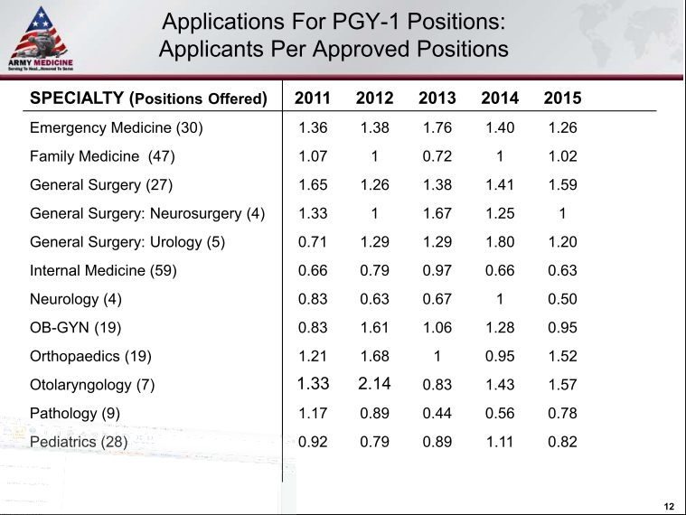
Match Data ARMY

Slide 68
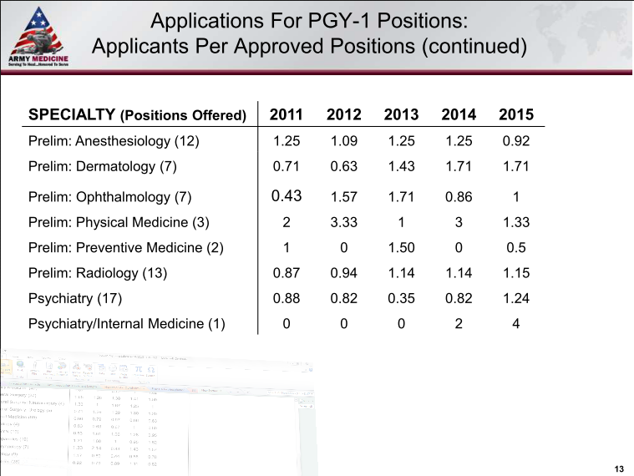
Match Data ARMY

Slide 69
NAVY Specifics

Slide 70
NAVY Specifics

Slide 71
PGY 1 Sample

Slide 72
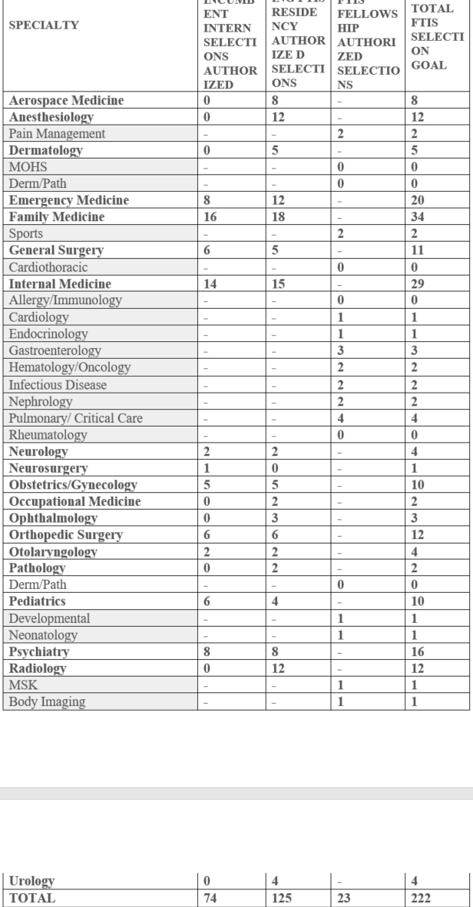
PGY 2+ Example
(*FITS =Full time in service)

Slide 73
Good Luck with Medical School and Your Military Medicine Career!

